Slide 1

Python Application in DIgSILENT PowerFactory
International Internship Pilot Program (IIPP) by NSTC
Created by Firas Quthbi Sidqi (V133010001)
Supervisor: Dr. Mohammed Manaz
Smart Energy Systems Lab

Slide 2
Outline
Learning reason
Prior knowledge
Python Preparation
Introduction
Tutorial_Python Chapter 1
Tutorial_Python Chapter 2
Python logic
Post test

Slide 3
Learning Reason
(Why should we use Python in DIgSILENT PowerFactory?)

Slide 4
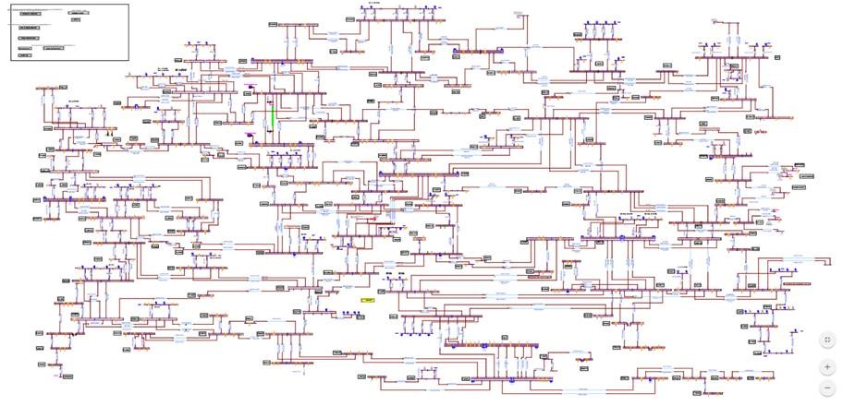
Consider you are working with this SLD
Image source: emtp

Slide 5
Background reason
Suppose you want to know the best bus for one Photovoltaic (PV) placement, considering the minimum losses. Will you connect the PV one by one?
Suppose you have 5 PV that should be installed, there will be a lot of combinations.

Slide 6
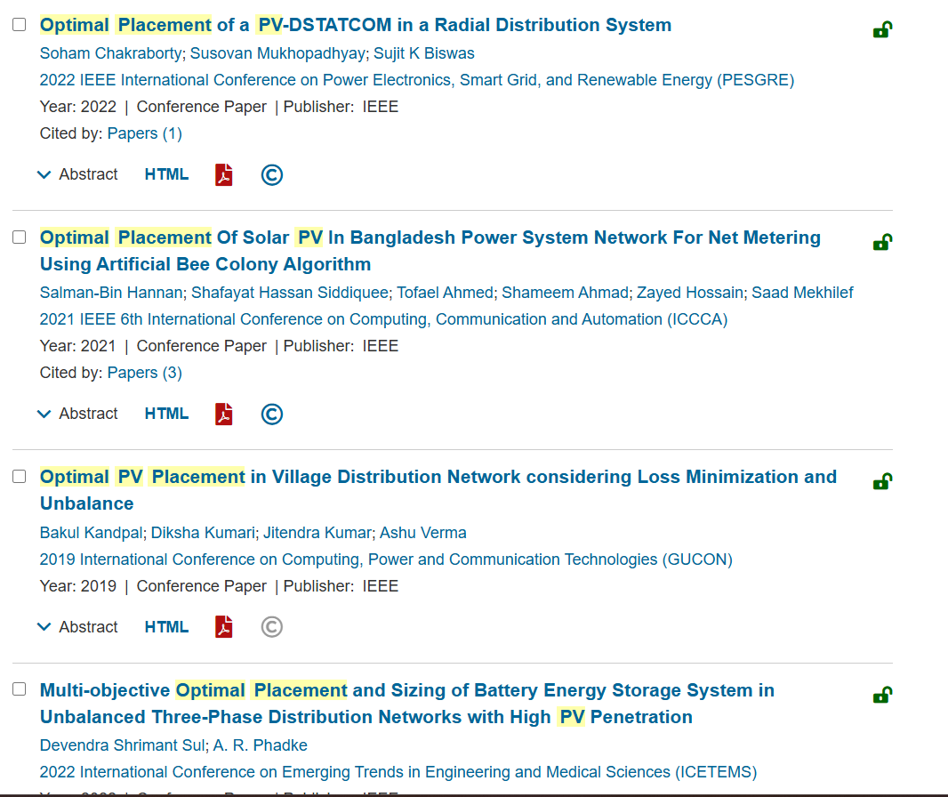
Look at these publications

Slide 7
Background reason
Most of the mentioned publications use Matlab with Matpower.
Matlab is good for learning the calculation fundamentals (AC-DC Power Flow, Short Circuit, Unit Commitment).
But the modelling accuracy is not as good as in commercial software such as DIgSILENT PowerFactory, ETAP, PSCAD, PSSE, etc.

Slide 8
Background reason
The modelling skills in the mentioned commercial software would lead to a better career.
Python is free!
Commercial software might not be free, but it is still free while you are a student!

Slide 9
Prior Knowledge
(What to know before learning Python in PowerFactory)

Slide 10
Prior Knowledge
Basic modelling skills in DIgSILENT PowerFactory
Basic simulation skills including Load Flow, Short Circuit, RMS Simulation, Unit Commitment, etc.
Basic Python knowledge
Data structure inside DIgSILENT PowerFactory
We will not explain more about 1, 2, and 3.
We will focus more on 4 since the majority of people skip this.

Slide 11
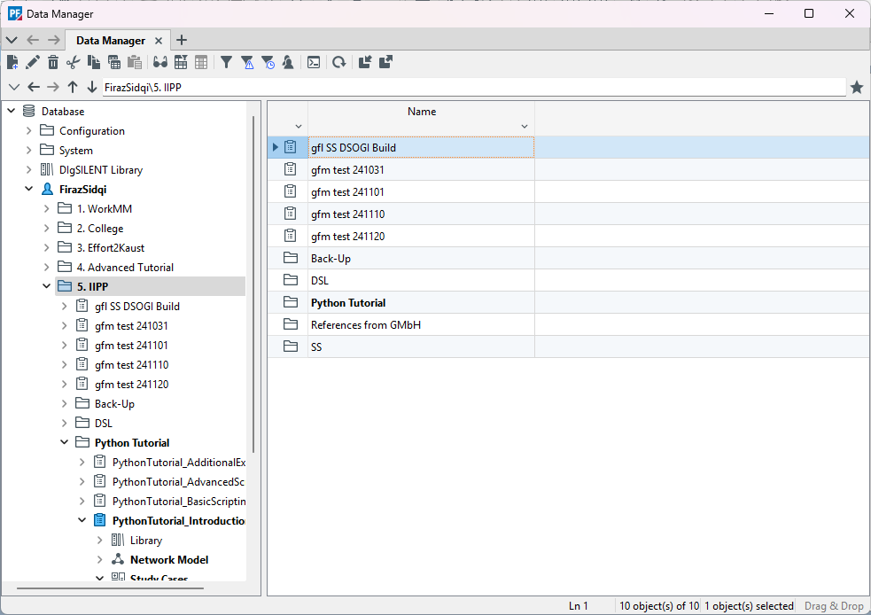
Data structure inside DIgSILENT PowerFactory
Look at the Data Manager window below.
Image source: personal documentary

Slide 12
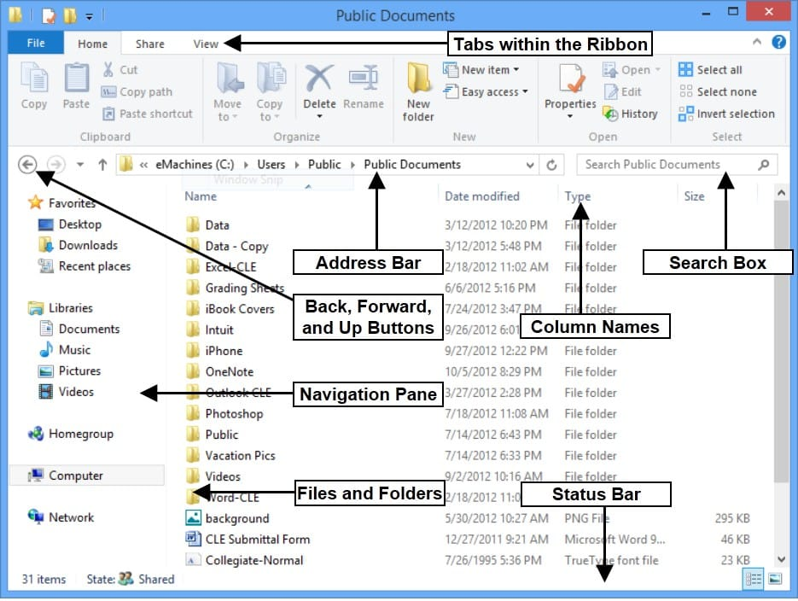
Compare it with the “Windows Explorer” window
Image source: teachucomp

Slide 13
They look quite similar right?
There are several similarities between both. Such as:
Address bar / Directory bar
Back, forward, up and down buttons
Navigation pane
Files and Folders

Slide 14
What other similarities?
Every file in Windows Explorer has its own Extension. Such as:
PDF files : .pdf
Compressed files : .zip, .rar, .7z
Microsoft Office files : .docx, .pptx, .xlsx
It is worth noting that All files inside PowerFactory Data Manager have their extensions as well. Such as:
Project files : .IntPrj,
Study Case : .IntCase
Even a single component like a synchronous machine has an extension (.ElmSym)

Slide 15
Since you know that they are similar
Now get used to it by starting to do these things:
When you activate your project, use data manager.
When you export your project, use data manager.
When you want to delete your project, use data manager.
When you want to navigate and organise your internal database, use data manager.
When you want to run a load flow, use data manager.

Slide 16
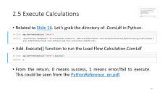

How to Run Load Flow from Data Manager?
Import any of the .pfd files in this GitHub link and activate
Go to the Data Manager windows
By using the navigation pane, go to {username}\{activated project}\Study Cases\Study Case
Double Click on Load Flow Calculation
Execute
Basically, this procedure is similar to when you open an .exe file in Windows

Slide 17
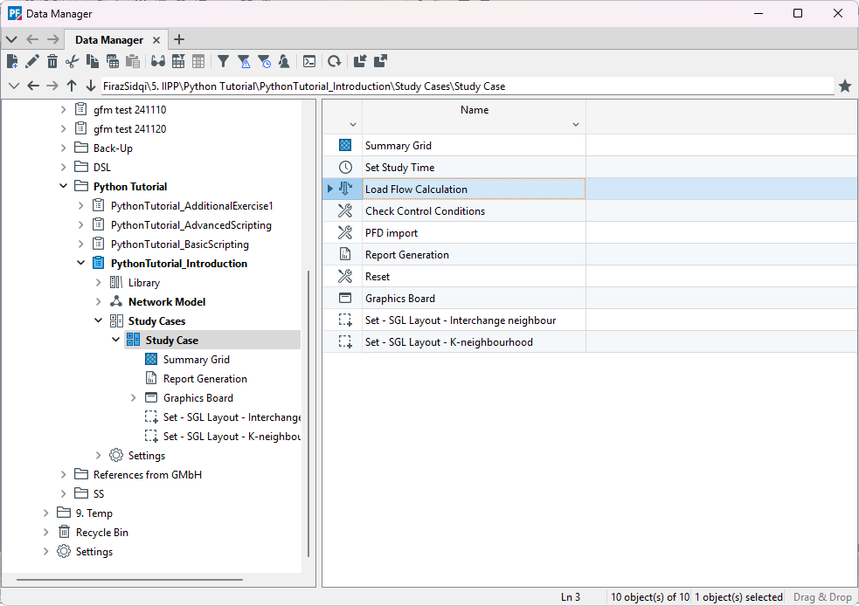
Location of Load Flow Calculation.ComLdf

Slide 18
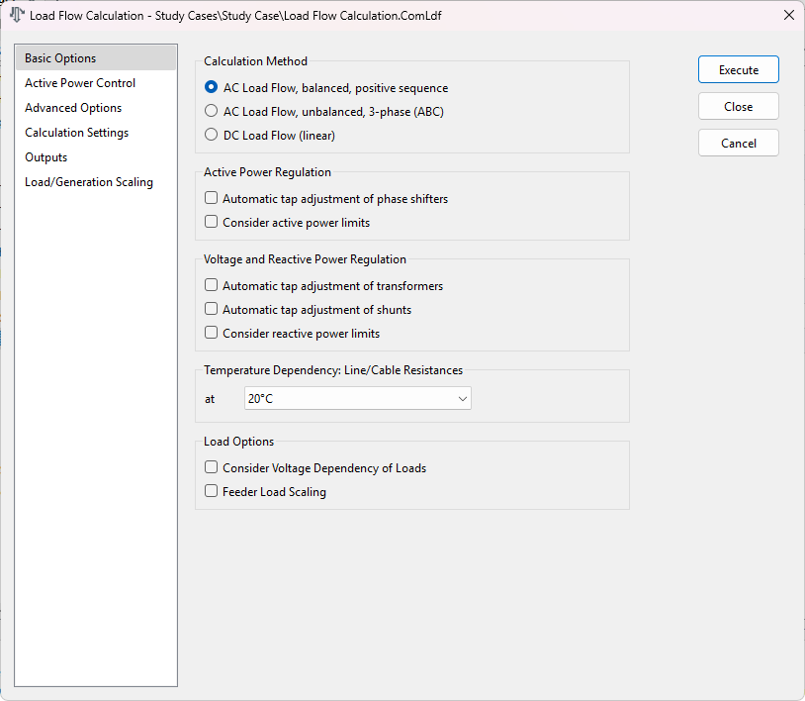
It will open the Load Flow window, Execute

Slide 19
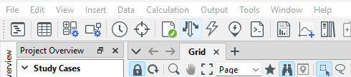
So, why do it the hard way?
The quickest way to run load flow is by clicking this button, a fact that many of us are already aware of.
But in Python, you cannot click that button anymore to run the load flow. You need to open the Load Flow Calculation.ComLdf by using the location where it is stored. It is applicable not only for load flow but for everything.
We will learn about it deeper on the next section.

Slide 20
Python Preparation
(How to install Python environment in Windows)

Slide 21
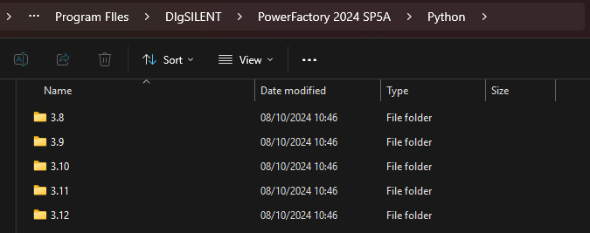
Set-up Python Installation
Since DIgSILENT PowerFactory is only available in Windows, so we will set up the Python in Windows.
Download and extract the WinPython V 3.9.10.
Why use WinPython? It is portable, simple, and complete.
Why version 3.9.10? V3.9.10 is supported on PowerFactory 2019 - 2025

Slide 22
The Usage of Jupyter Notebook (.ipynb)
From WinPython, open Jupyter Notebook.
There are 2 reasons to use Jupyter Notebook:
Cell management, useful for troubleshooting the script
Better IDE compared to DIgSILENT PowerFactory Script IDE

Slide 23
Python Introduction
(Non Interactive Mode)

Slide 24


Internal Python vs External Python
In this session, we will learn how to integrate Python and PowerFactory from the external side.
The official tutorial in Tutorial_Python.pdf utilizes an internal scripting IDE for Python. However, we believe that learning through Jupyter Notebook generally allows individuals to learn more effectively. In contrast, the internal IDE is the most suitable choice for learners of the DIgSILENT Programming Language (DPL).
So, it is needed to know that in this PowerPoint Session, we will redo everything from Tutorial_Python.pdf but in the Jupyter Notebook environment.

Slide 25
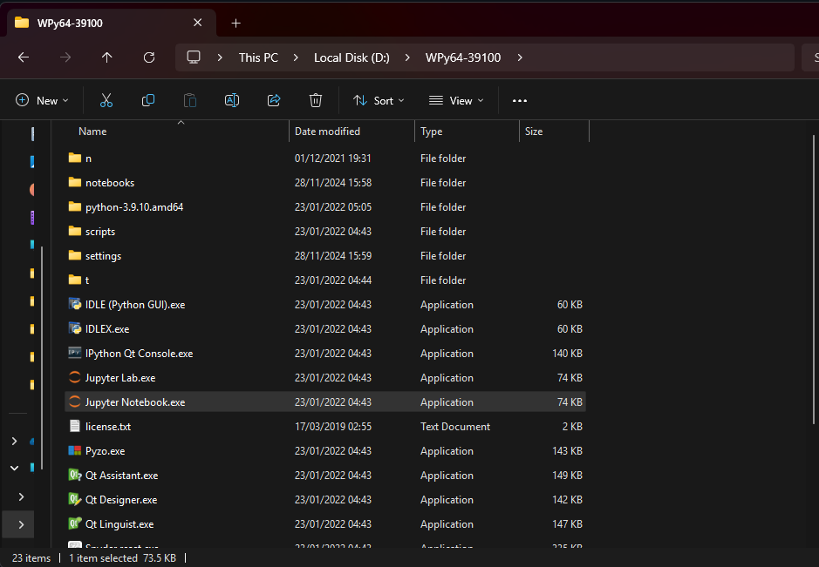
Open Jupyter Notebook

Slide 26
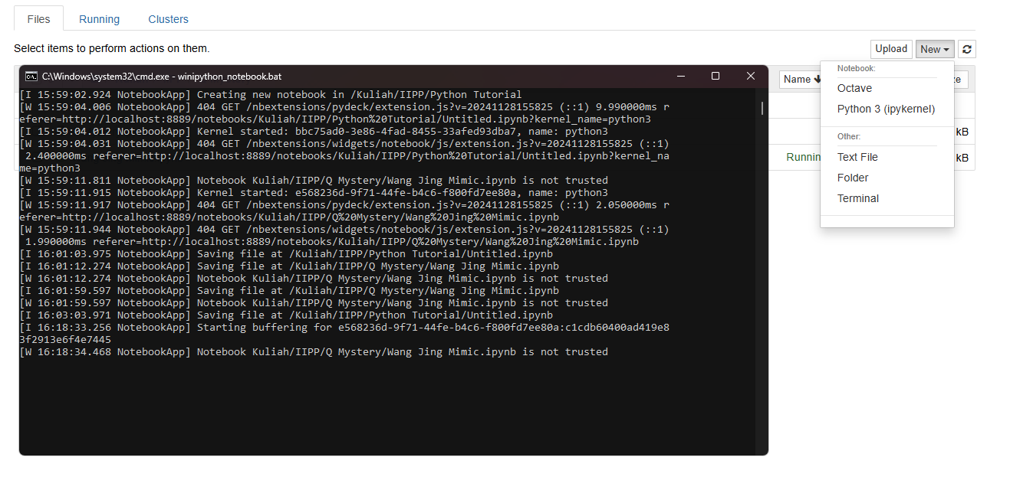
cmd.exe will pop up together with a browser tab. Create a new Python 3 (ipykernel)

Slide 27
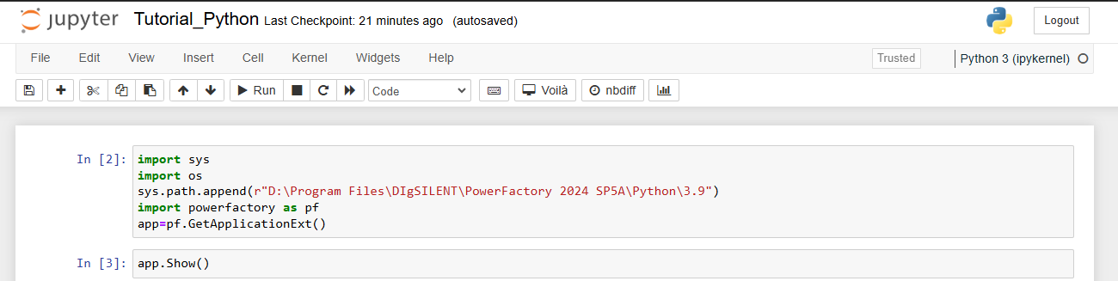
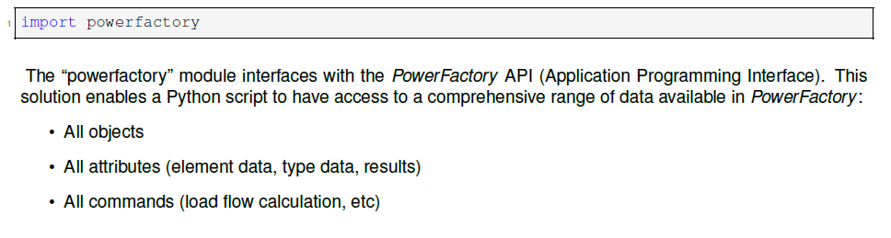
Rename the notebook to “Tutorial_Python”
Create and type these 2 cells, change “D:\Program Files\DIgSILENT\PowerFactory 2024 SP5A\Python\3.9” with the equal directory of PowerFactory Python Module.
Run the 2 cells, and PowerFactory non-interactive mode will appear.
Note that the explanation of cell 1 could be obtained from Tutorial_Python.pdf or PythonReference_en.pdf. Below is just example of explanation.

Slide 28
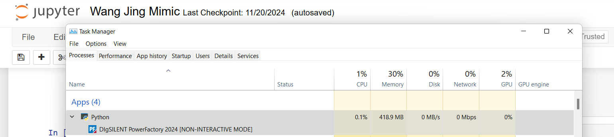
Limitations in External Python
When we import PowerFactory as pf, Python Kernel start to run PowerFactory.
It could be seen from the Task Manager, that PowerFactory is not opened via the Windows itself, but it is opened via Python. You can check it by yourself

Slide 29

Limitations in External Python
Therefore, we are prohibited from closing the PowerFactory directly through the Windows User Interface, like in the picture below.
If you want to close the PowerFactory because you have finished your work, just close the cmd.exe that opens the Jupyter Notebook.
If you want to close the PowerFactory to fasten the simulation time, use the command “app.Hide()”

Slide 30
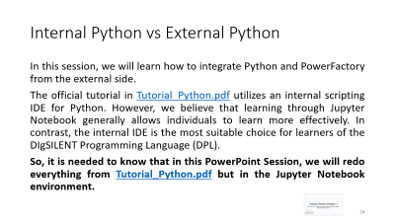
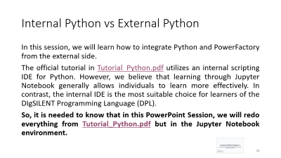
Tutorial_Python Chapter 1
(As mentioned in slide 24, we will do the tutorial with Jupyter Notebook Environment)

Slide 31

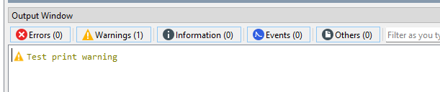
1.3.2 Write messages to the output window
Let’s run Warning messages in Jupyter Notebook:
Check in the PowerFactory output window, it should appear like this:

Slide 32
Congrats! Now your Jupyter Notebook (Python) has already integrated with PowerFactory

Slide 33
Tutorial_Python Chapter 2
(Basic Python Scripting)

Slide 34
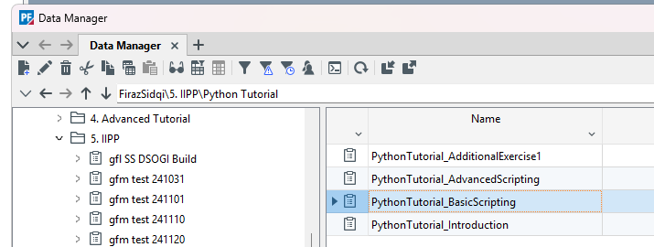
Let’s first activate the project from Python
Look for the project’s directory/location in the Data Manager
For my directory, I use the script below:

Slide 35
Let’s first activate the project from Python
Here is the main idea.
To activate the project, we must call the project location/directory.
app.GetCurrentUser() will call the user inside PowerFactory
GetContents() will call the children’s folder
If you are curious, just run app.GetCurrentUser().GetContents() and observe what is the output
Jupyter Notebook will be the best to apply some portion of the script and try that before combining it with the bigger script

Slide 36
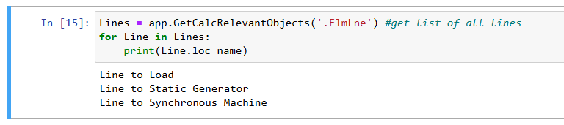
2.1 Access Network Objects
Rather than import again, directly write these lines:
We do not need to import Powerfactory and define app except the Notebook is restarted.
Also instead of print the Line name in the PowerFactory output window, we can print it directly to the Notebook

Slide 37
2.2 Identify, Access and Modify Object Parameters
To identify the element parameters, we need to hover a cursor to the UI. For example, we want to change the length of “Line to Load”. We need to access the line first.

Slide 38
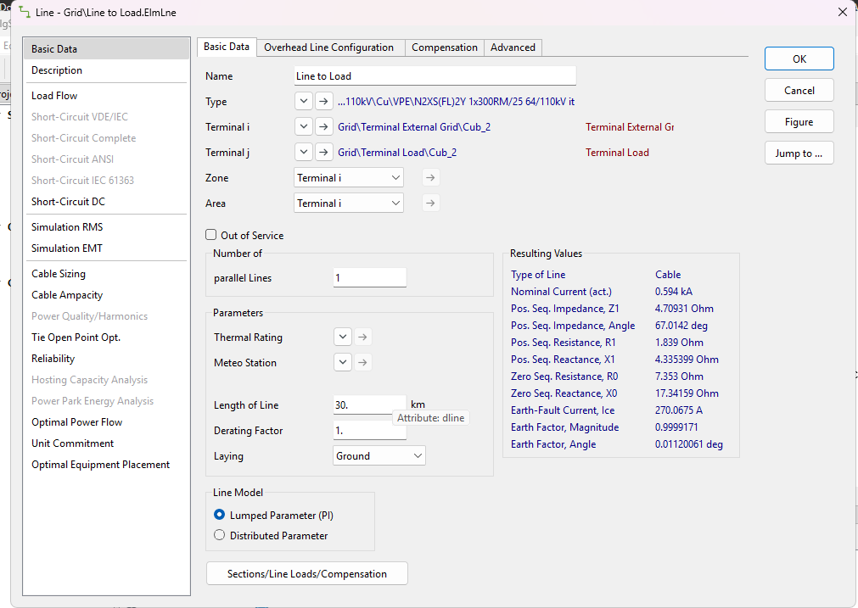

2.2 Identify, Access and Modify Object Parameters
Then open any line, hover to the length parameter
We got the variable dline
Call it in the Python

Slide 39
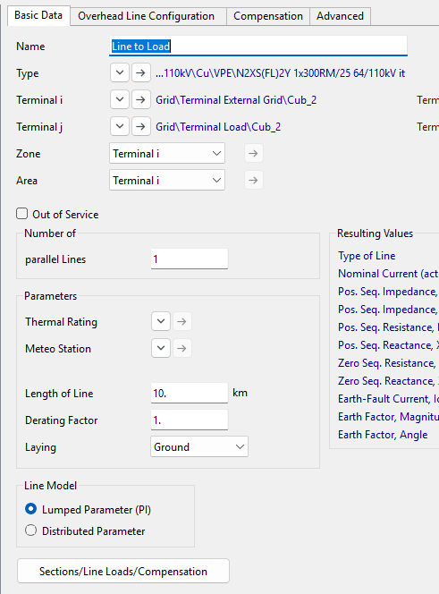

2.2 Identify, Access and Modify Object Parameters
To change the value, just do it straightforward
Check the result in the PowerFactory User Interface

Slide 40
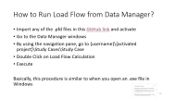
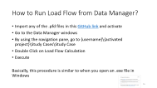
2.5 Execute Calculations
Related to Slide 16. Let’s grab the directory of .ComLdf in Python.
Add .Execute() function to run the Load Flow Calculation.ComLdf
From the return, 0 means success, 1 means error/fail to execute. This could be seen from the PythonReference_en.pdf.

Slide 41
Python Logic
(Basic Python Scripting)

Slide 42
Overall Logic in Python
All activities in PowerFactory can be done using Python, the only requirement is the directory of the object/element/variables inside PowerFactory.
Within a few trials in this PowerPoint, I hope anyone can do the rest of the examples in the Tutorial_Python.pdf by using Jupyter Notebook IDE.

Slide 43
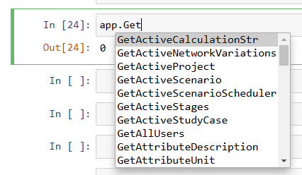
Some Tips
Sometimes if we forget the syntax, rather than opening the PythonReference_en.pdf, pressing TAB in the middle of the syntax will give us a hint.

Slide 44
Post Test
(Please do this after finishing the Tutorial_Python.pdf.)

Slide 45
Run PV Placement with minimum loss
Download the PowerFactory project file and the Python Script in GitHub.
Import the project.
Move the Python Script “PLTS Placement.ipynb” to the Jupyter Notebook directory “WPy64-39100/notebooks”
Run the Python script
Learn from the Python script
Create 2 or more PV systems in PowerFactory, then look for the best placement combination by targeting the minimal losses using numerical methods, AI, etc.

